Slide 1

AUTOMATED HUMAN - WILDLIFE CONFLICT MONITORING SYSTEM USING DEEP LEARNING

Slide 2
Contents
Introduction
Literature Survey
Problem Statement
Objective
Methodology
Software Design
Conclusion

Slide 3
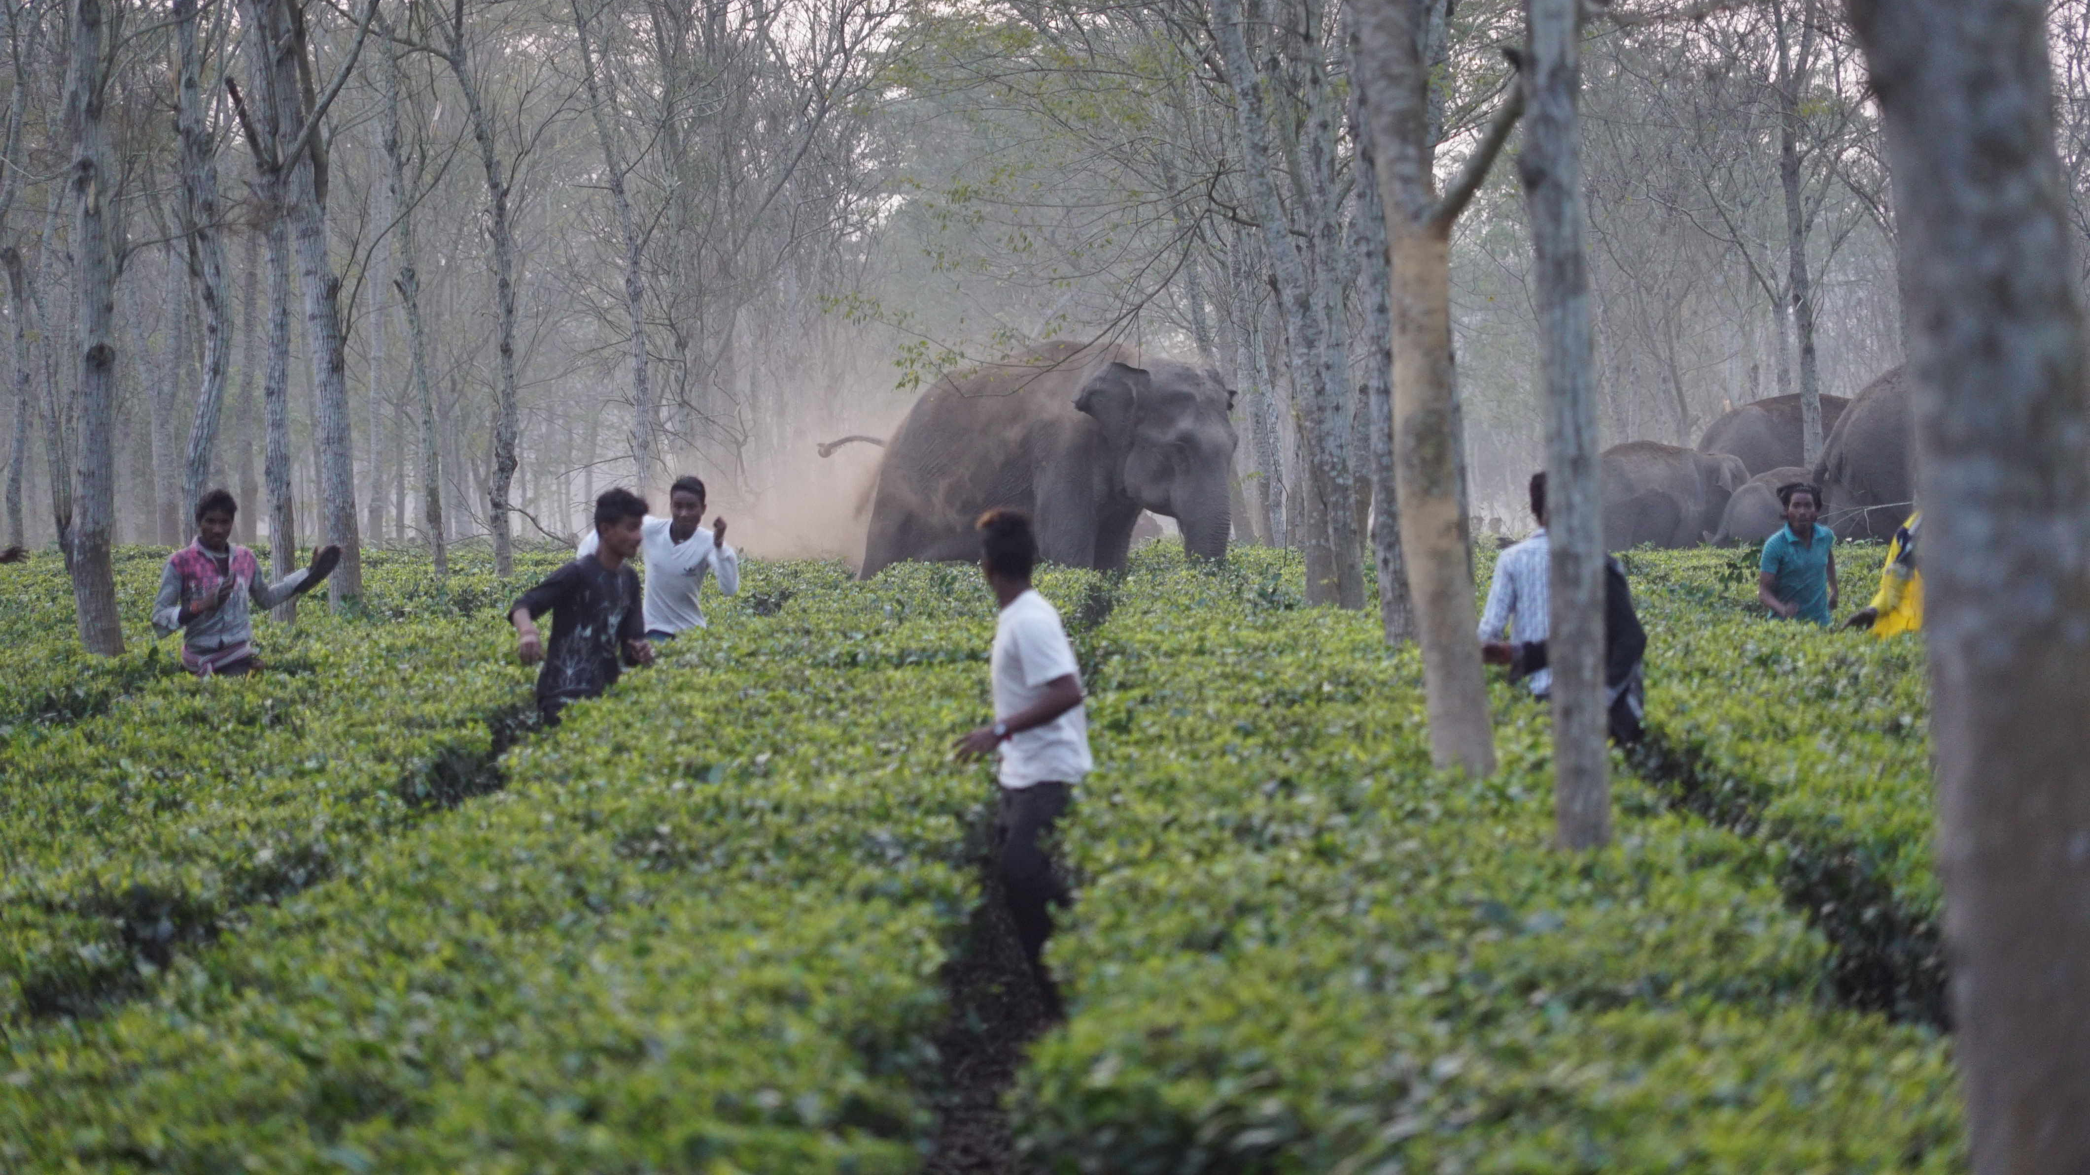
Introduction
This project mainly aims forest border security which will consider well-being of both humans in the border region and wild animals.
Many no of camera traps are used in the forest to monitor the presence of animal.

Slide 4
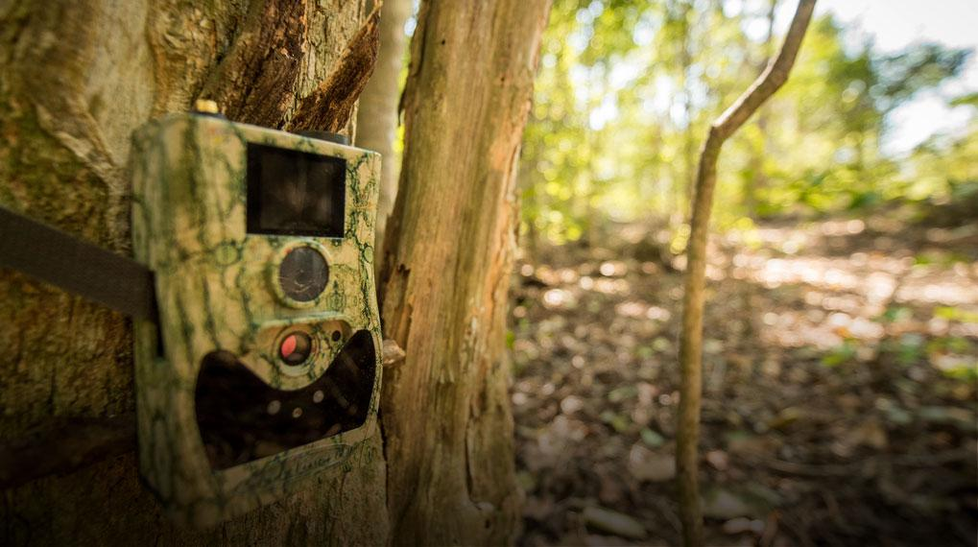
Introduction
System should be capable of filtering out the images which contain animal.
After the detection of the presence of an animal, it should recognize the species of the animal in which it belongs.

Slide 5
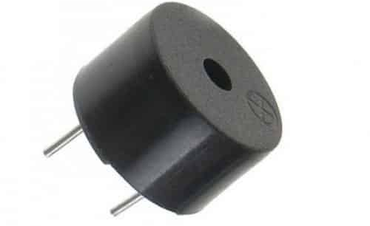
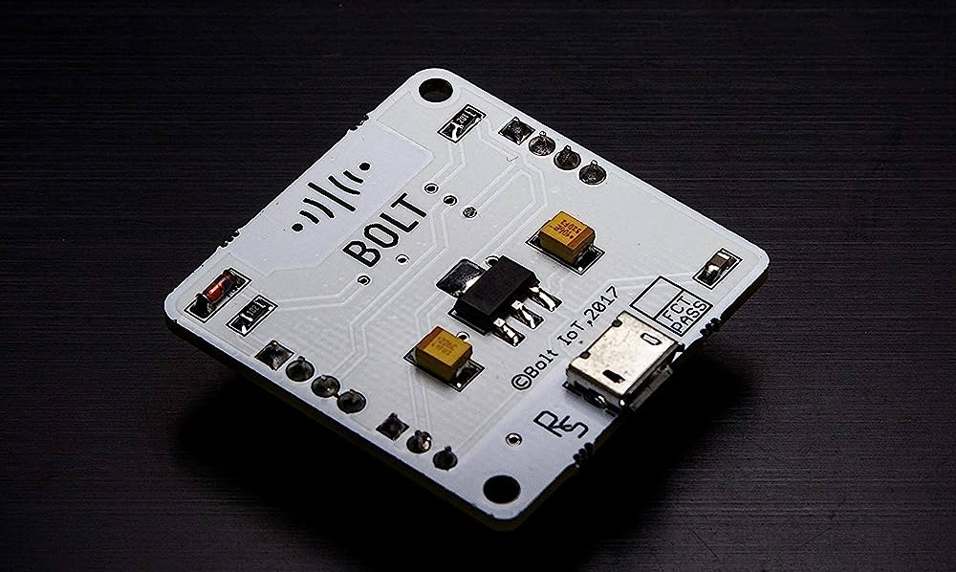
Introduction
Bolt IoT Wi-Fi Module is used
Bolt IoT Wi-Fi Module is connected with Piezo Buzzer which produces audio of different frequencies.

Slide 6
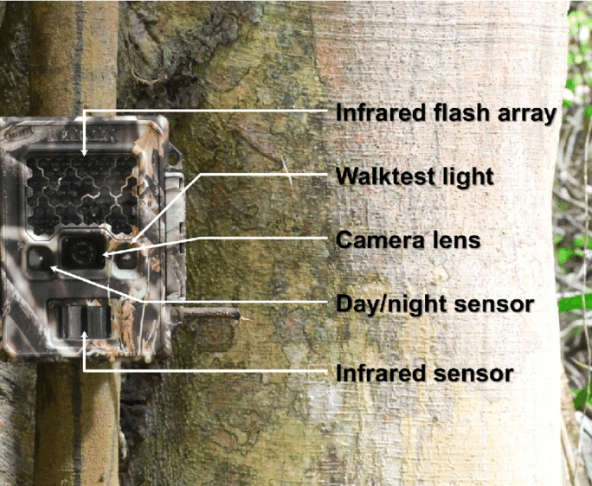
Literature Survey
E. Znidersic, "Camera Traps are an Effective Tool for Monitoring Lewin’s Rail (Lewinia pectoralis brachipus), " Waterbirds, vol. 40, no.4,pp.417422,Dec.2017, https://doi.org/10.1675/063.040.0414.
Camera traps have gained popularity in wildlife monitoring and surveys because of their efficiency in collecting wildlife images without monitoring.
They need slight improvements, such as the ability to use microcomputers which support machine learning algorithms to support early warning systems.

Slide 7
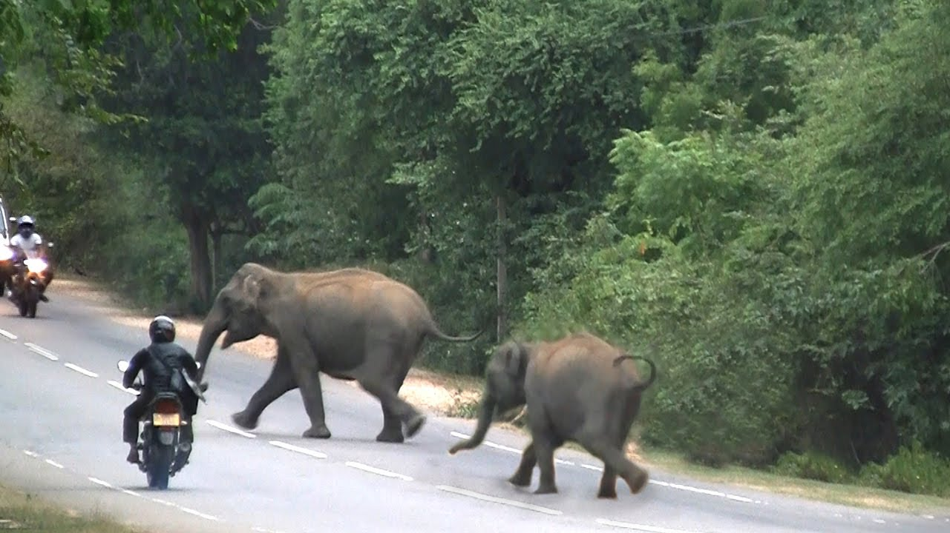
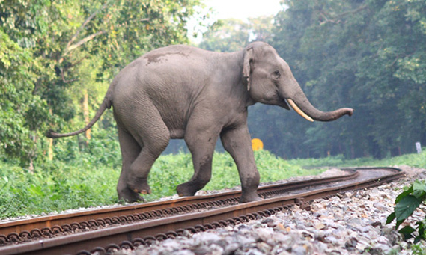
Literature Survey
Duhart C, Dublon G, Mayton B, and Paradiso J. ‘Deep Learning Locally Trained Wildlife Sensing in Real Acoustic Wetland Environment’. In Thampi SM, Marques O, Krishnan S, Ciuonzo D and Kolekar MH (eds.), Advances in Signal Processing and Intelligent Recognition Systems, 2019: 3–14.
Identifying the sound of animals and processing it by concepts of signal processing and deep learning.

Slide 8
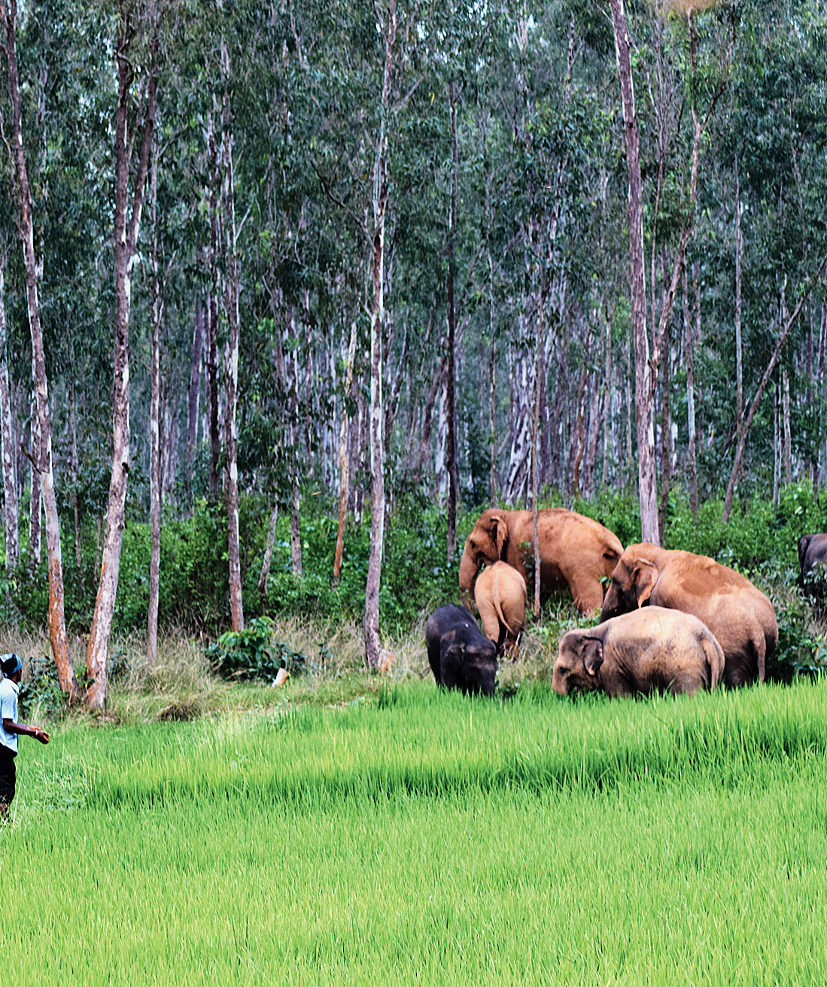
Problem Statement
A deadly conflict is prominently observed between India's growing masses and its wildlife. Damage to human property, crop damage, a threat to livestock, are some of its major impacts.
The proposed system aims in protecting human habitation and livestock at the outskirts of the forest area by developing an automated system that detects the intrusion of wild animals and repels them back to the forest without causing any harm.

Slide 9

Objective
The main objective of the project is to safe guard
the agricultural field from wild animals and also
to protect them by driving them away instead of
killing. The project also aims to protect human
lives from animal attacks. We are using an
integrative approach in the field of Deep Learning
to provide a monitoring and repelling system for
crop protection against animal attacks.

Slide 10
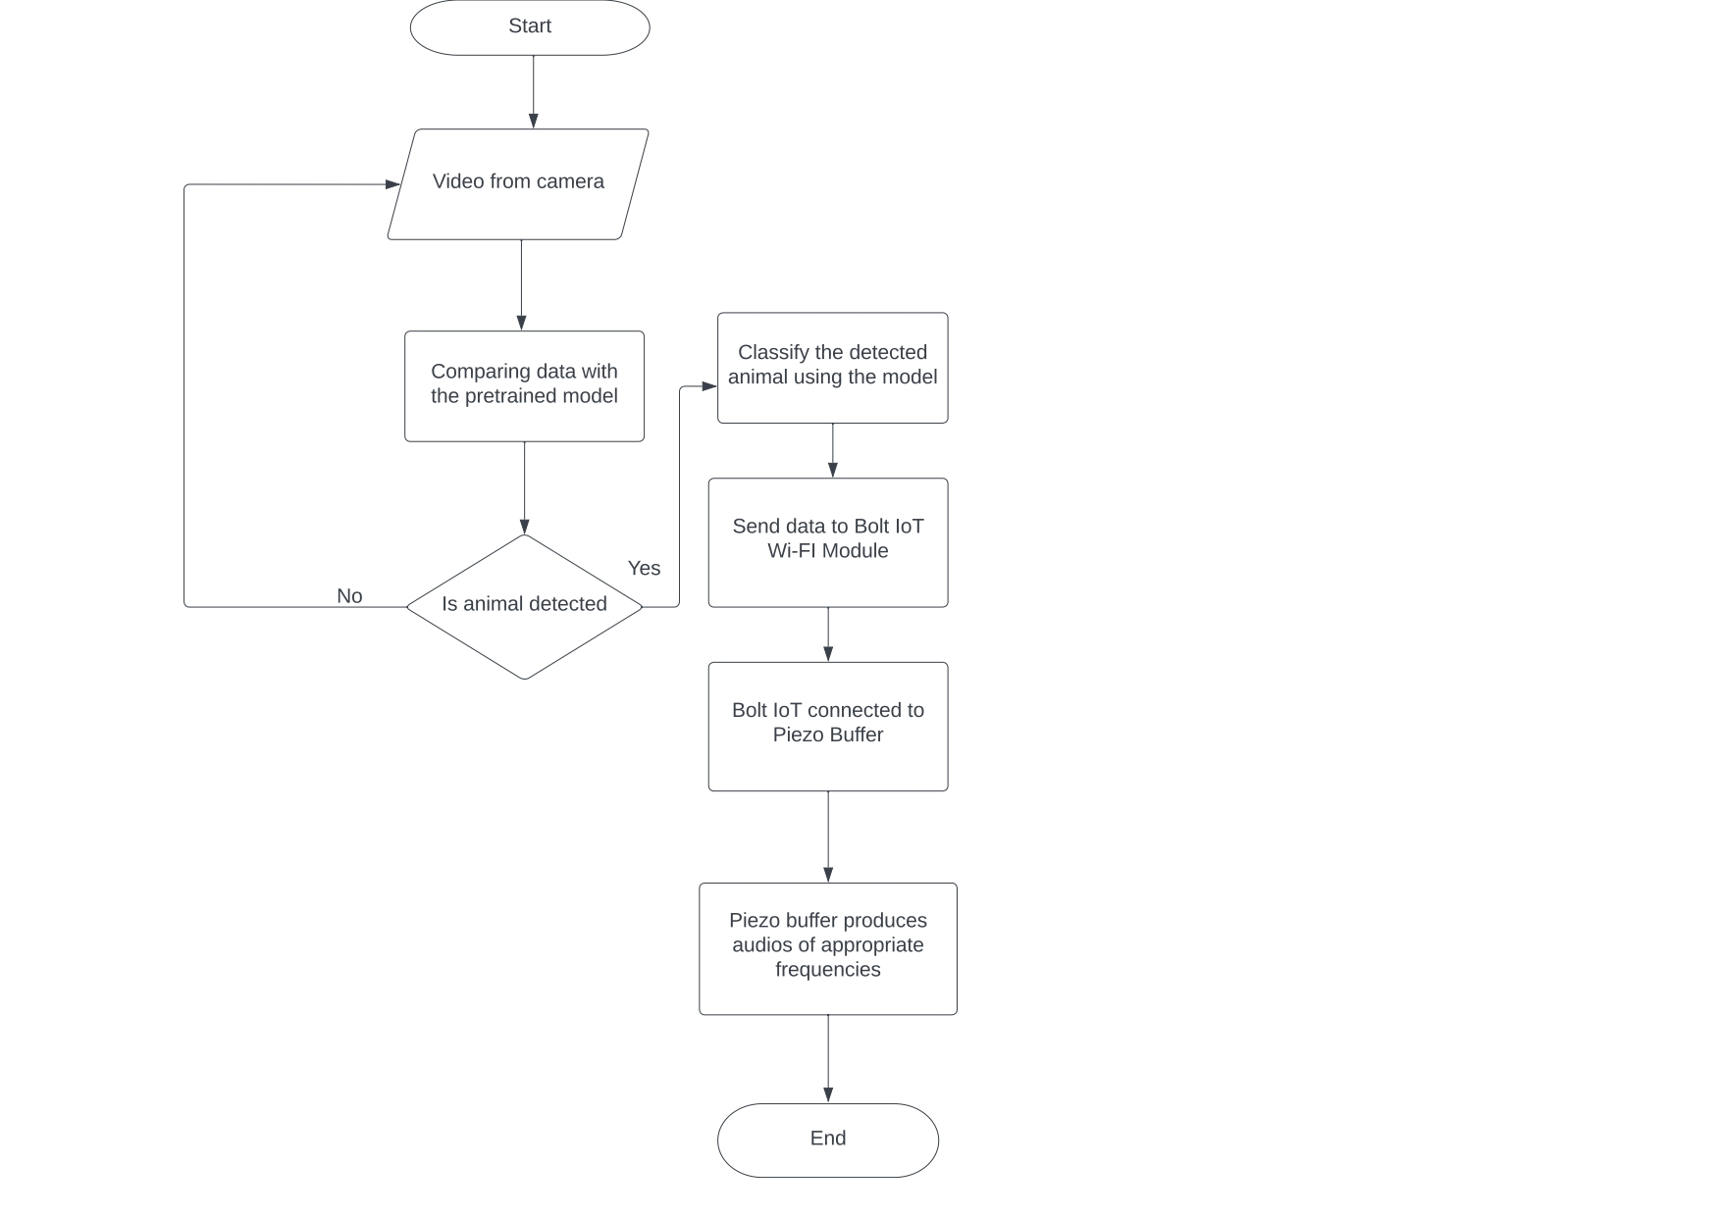
Methodology
Real – time detection of animal using a camera.
Continuously comparing the stream of video with the pretrained model – YoloV3.
Send the data to Bolt IoT Wi - Fi module.
Bolt IoT connected to piezo buzzer.
Piezo buzzer produces appropriate sound for each animal detected.

Slide 11

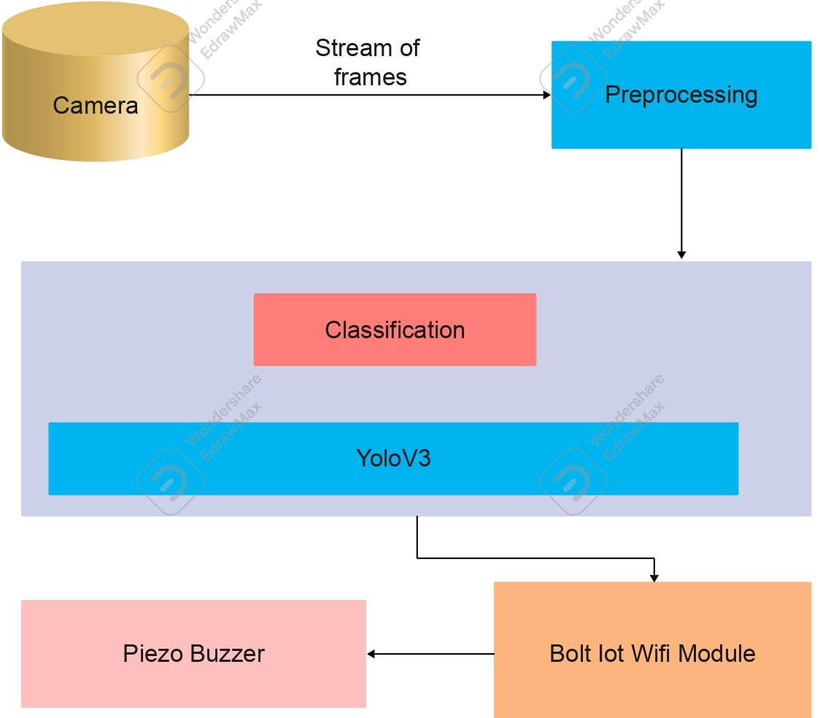
Software Design

Slide 12
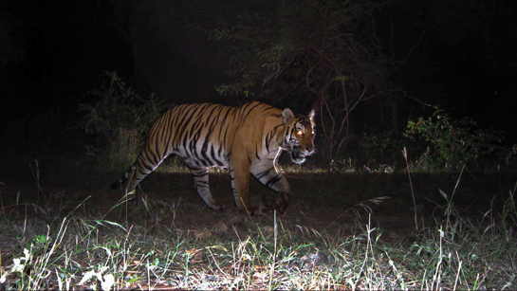
Conclusion
Animal detection methods are very useful for many real time applications. Automated animal detection, localization, and species recognition lie in the heart of automated camera-trap image analysis. Here, the animals are detected in real – time. After predicting an animal, it will pass the predicted data to the Bolt IoT Wi-Fi module. Appropriate frequency of sound arrays are passed for different animals on to the piezo buzzer which is connected to the Bolt module. Thus, after detecting the animal, the piezo buzzer will produce sound.

Slide 13

Presented By:
Prakash Roy (252)
Harisankar J S (238)
Sandeep S L (256)
Guided By:
Mrs. Sruthy Shaiju

Slide 14


